Slide 1



CST 347 – Real Time OS
Lecture 12 – Synchronization I
Troy Scevers

Slide 2
Topics
Background
The Critical-Section Problem
Peterson’s Solution
Synchronization Hardware

Slide 3
Background
Processes can execute concurrently
May be interrupted at any time, partially completing execution
Concurrent access to shared data may result in data inconsistency
Maintaining data consistency requires mechanisms to ensure the orderly execution of cooperating processes
Illustration of the problem:
Suppose that we wanted to provide a solution to the consumer-producer problem that fills all the buffers. We can do so by having an integer counter that keeps track of the number of full buffers. Initially, counter is set to 0. It is incremented by the producer after it produces a new buffer and is decremented by the consumer after it consumes a buffer.

Slide 4
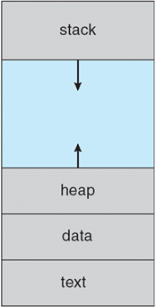
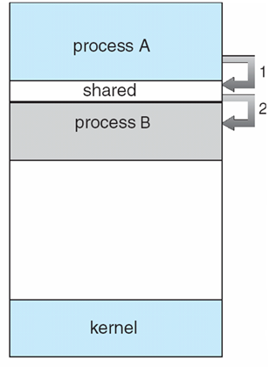
Shared Memory IPC
Producer
Consumer

Slide 5
Shared Memory IPC
Critical
Sections

Slide 6
Critical Sections
Code that accesses/modifies shared resources
Examples
Shared memory
Message passing
Concurrency means processes can be interrupted, allowing another process to run
Race conditions can occur
Machine execution sequence matters
Synchronization to

Slide 7
Producer
while (true)
{ /* produce an item in next produced */
while (counter == BUFFER_SIZE); /* do nothing */
buffer[in] = next_produced;
in = (in + 1) % BUFFER_SIZE;
counter++;
}

Slide 8
Consumer
while (true)
{
while (counter == 0); /* do nothing */
next_consumed = buffer[out];
out = (out + 1) % BUFFER_SIZE;
counter--;
/* consume the item in next consumed */
}

Slide 9
Race Condition
counter++ could be implemented as
register1 = counter
register1 = register1 + 1
counter = register1
counter-- could be implemented as
register2 = counter
register2 = register2 – 1
counter = register2
Consider this execution interleaving with “count = 5” initially:
S0: producer execute register1 = counter {register1 = 5}
S1: producer execute register1 = register1 + 1 {register1 = 6}
S2: consumer execute register2 = counter {register2 = 5}
S3: consumer execute register2 = register2 – 1 {register2 = 4}
S4: producer execute counter = register1 {counter = 6 }
S5: consumer execute counter = register2 {counter = 4}

Slide 10
Illustration of the Problem
// Producer
while (true) { /* produce an item in next produced */
while (counter == BUFFER SIZE); /* do nothing */
buffer[in] = next produced;
in = (in + 1) % BUFFER SIZE;
counter++;
}
// Consumer
while (true) {
while (counter == 0); /* do nothing */
next consumed = buffer[out];
out = (out + 1) % BUFFER SIZE;
counter--;
/* consume the item in next consumed */
}

Slide 11
Illustration of the Problem
// Assume counter++ implemented as
la t9, counter
lw t0, 0(t9)
addi t0, t0, 1
sw t0,0(t9)
Execution of producer
la t9, counter // t9 = counter address
lw t0, 0(t9) // t0 = 5
addi t0, t0, 1 // t0 = 6
{interruption}
sw t0,0(t9) // counter = 6 !!!
{interruption}
// Assume counter–- implemented as
la t8, counter
lw t1, 0(t8)
addi t1, t1, -1
sw t1,0(t8)
Execution of consumer
la t8, counter // t8 = counter address
lw t1, 0(t9) // t1 = 5
addi t1, t1, -1 // t1 = 4
{interruption}
sw t1,0(t8) // counter = 4 !!!
Assume initially count = 5

Slide 12
Critical Section Problem
Consider system of n processes {p₀, p₁, … p_{n-1}}
Each process has critical section segment of code
Process may be changing common variables, updating table, writing file, etc
When one process in critical section, no other may be in its critical section
Critical section problem is to design protocol to solve this
Each process must ask permission to enter critical section in entry section, may follow critical section with exit section, then remainder section

Slide 13
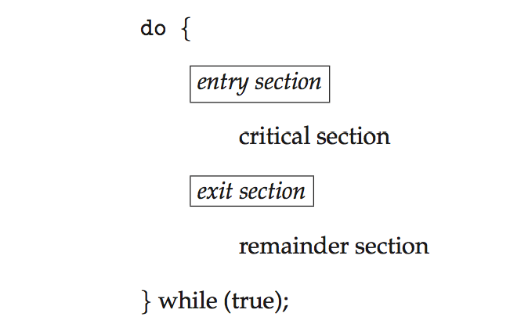
Critical Section
General structure of process p_{i} is

Slide 14
Solution to Critical-Section Problem
Mutual Exclusion
If process Pi is executing in its critical section, then no other processes can be executing in their critical sections
Progress
If no process is executing in its critical section and there exist some processes that wish to enter their critical section, then the selection of the processes that will enter the critical section next cannot be postponed indefinitely
Bounded Waiting
A bound must exist on the number of times that other processes are allowed to enter their critical sections after a process has made a request to enter its critical section and before that request is granted
Assume that each process executes at a nonzero speed
No assumption concerning relative speed of the n processes
Two approaches depending on if kernel is preemptive or non-preemptive
Preemptive – allows preemption of process when running in kernel mode
Non-preemptive – runs until exits kernel mode, blocks, or voluntarily yields CPU
Essentially free of race conditions in kernel mode

Slide 15
Peterson’s Solution
Good algorithmic description of solving the problem
Two process solution
Assume that the load and store instructions are atomic; that is, cannot be interrupted
The two processes share two variables:
int turn;
bool flag[2]
The variable turn indicates whose turn it is to enter the critical section
The flag array is used to indicate if a process is ready to enter the critical section. flag[i] = true implies that process P_{i} is ready!

Slide 16
Peterson’s Solution (Software)
// Process 1
do
{
flag[1] = TRUE;
turn = 0;
while(flag[0]==TRUE && turn==0);
// critical section 1
flag[1] = FALSE;
// remainder section 1
} while(1);
// Process 0
do
{
flag[0] = TRUE;
turn = 1;
while(flag[1]==TRUE && turn==1);
// critical section 0
flag[0] = FALSE;
// remainder section 0
} while(1);

Slide 17
Peterson’s Solution (Software)
// Process 1
do
{
flag[1] = TRUE;
turn = 0;
while(flag[0]==TRUE && turn==0);
// critical section 1
flag[1] = FALSE;
// remainder section 1
} while(1);
// Process 0
do
{
flag[0] = TRUE;
turn = 1;
while(flag[1]==TRUE && turn==1);
// critical section 0
flag[0] = FALSE;
// remainder section 0
} while(1);
entry section
exit section

Slide 18
Condition 1: Mutual Exclusion
flag[0] = TRUE;
turn = 1;
while(flag[1]==TRUE && turn==1);
// critical section 0 start

Slide 19
Condition 1: Mutual Exclusion
flag[0] = TRUE;
turn = 1;
while(flag[1]==TRUE && turn==1);
// critical section 0 start
flag[1] = TRUE;
turn = 0;
while(flag[0]==TRUE && turn==0);

Slide 20
Condition 1: Mutual Exclusion
flag[0] = TRUE;
turn = 1;
while(flag[1]==TRUE && turn==1);
// critical section 0 start
flag[1] = TRUE;
turn = 0;
while(flag[0]==TRUE && turn==0);

Slide 21
Condition 1: Mutual Exclusion
flag[0] = TRUE;
turn = 1;
while(flag[1]==TRUE && turn==1);
// critical section 0 start
// critical section 0 finish
flag[0] = FALSE;
// remainder section 0
flag[1] = TRUE;
turn = 0;
while(flag[0]==TRUE && turn==0);

Slide 22
Condition 1: Mutual Exclusion
flag[0] = TRUE;
turn = 1;
while(flag[1]==TRUE && turn==1);
// critical section 0 start
// critical section 0 finish
flag[0] = FALSE;
// remainder section 0
flag[1] = TRUE;
turn = 0;
while(flag[0]==TRUE && turn==0);
while(flag[0]==TRUE && turn==0);
// critical section 1 start

Slide 23
Condition 1: Mutual Exclusion
flag[0] = TRUE;
turn = 1;
while(flag[1]==TRUE && turn==1);
// critical section 0 start
// critical section 0 finish
flag[0] = FALSE;
// remainder section 0
flag[1] = TRUE;
turn = 0;
while(flag[0]==TRUE && turn==0);
while(flag[0]==TRUE && turn==0);
// critical section 1 start

Slide 24
Condition 1: Mutual Exclusion
flag[0] = TRUE;
turn = 1;
while(flag[1]==TRUE && turn==1);
// critical section 0 start
// critical section 0 finish
flag[0] = FALSE;
// remainder section 0
flag[0] = TRUE;
turn = 1;
while(flag[1]==TRUE && turn==1);
flag[1] = TRUE;
turn = 0;
while(flag[0]==TRUE && turn==0);
while(flag[0]==TRUE && turn==0);
// critical section 1 start

Slide 25
Condition 1: Mutual Exclusion
flag[0] = TRUE;
turn = 1;
while(flag[1]==TRUE && turn==1);
// critical section 0 start
// critical section 0 finish
flag[0] = FALSE;
// remainder section 0
flag[0] = TRUE;
turn = 1;
while(flag[1]==TRUE && turn==1);
flag[1] = TRUE;
turn = 0;
while(flag[0]==TRUE && turn==0);
while(flag[0]==TRUE && turn==0);
// critical section 1 start

Slide 26
Condition 1: Mutual Exclusion
flag[0] = TRUE;
turn = 1;
while(flag[1]==TRUE && turn==1);
// critical section 0 start
// critical section 0 finish
flag[0] = FALSE;
// remainder section 0
flag[0] = TRUE;
turn = 1;
while(flag[1]==TRUE && turn==1);
flag[1] = TRUE;
turn = 0;
while(flag[0]==TRUE && turn==0);
while(flag[0]==TRUE && turn==0);
// critical section 1 start
// critical section 1 finish
flag[1] = FALSE;
// remainder section 1

Slide 27
Condition 1: Mutual Exclusion
flag[0] = TRUE;
turn = 1;
while(flag[1]==TRUE && turn==1);
// critical section 0 start
// critical section 0 finish
flag[0] = FALSE;
// remainder section 0
flag[0] = TRUE;
turn = 1;
while(flag[1]==TRUE && turn==1);
while(flag[1]==TRUE && turn==1);
// critical section 0 start
flag[1] = TRUE;
turn = 0;
while(flag[0]==TRUE && turn==0);
while(flag[0]==TRUE && turn==0);
// critical section 1 start
// critical section 1 finish
flag[1] = FALSE;
// remainder section 1

Slide 28
Condition 1: Mutual Exclusion
flag[0] = TRUE;
turn = 1;
while(flag[1]==TRUE && turn==1);
// critical section 0 start
// critical section 0 finish
flag[0] = FALSE;
// remainder section 0
flag[0] = TRUE;
turn = 1;
while(flag[1]==TRUE && turn==1);
while(flag[1]==TRUE && turn==1);
// critical section 0 start
flag[1] = TRUE;
turn = 0;
while(flag[0]==TRUE && turn==0);
while(flag[0]==TRUE && turn==0);
// critical section 1 start
// critical section 1 finish
flag[1] = FALSE;
// remainder section 1

Slide 29
Condition 1: Mutual Exclusion
flag[0] = TRUE;
turn = 1;
while(flag[1]==TRUE && turn==1);
// critical section 0 start
// critical section 0 finish
flag[0] = FALSE;
// remainder section 0
flag[0] = TRUE;
turn = 1;
while(flag[1]==TRUE && turn==1);
while(flag[1]==TRUE && turn==1);
// critical section 0 start
flag[1] = TRUE;
turn = 0;
while(flag[0]==TRUE && turn==0);
while(flag[0]==TRUE && turn==0);
// critical section 1 start
// critical section 1 finish
flag[1] = FALSE;
// remainder section 1

Slide 30
Hardware Solution
CPU “locking” mechanism
“TestAndSet” instruction
Atomic read-modify-write memory execution
e.g. MIPS – ll and sc instructions

Slide 31
Hardware Solution
CPU “locking” mechanism
“TestAndSet” instruction
Atomic read-modify-write memory execution
e.g. MIPS – ll and sc instructions
Atomic memory accesses
atomic_inc:
ll t0, 0(a0) # load linked
addiu t1, t0, 1 # increment
sc t1, 0(a0) # store cond'l
beqz t1, atomic_inc # loop if failed
nop

Slide 32
Hardware Solution
CPU “locking” mechanism
“TestAndSet” instruction
Atomic read-modify-write memory execution
e.g. MIPS – ll and sc instructions
Compare with non-atomic memory accesses
la t9, counter
lw t0, 0(t9)
addi t0, t0, 1
sw t0,0(t9)

